Slide 1
Arithmetical Languages for Policy
Jerome Ravetz
GECA
23 November 2017
7403

Slide 2
The management of uncertainty and quality in quantitative information is becoming recognised as an urgent challenge for policy-relevant science.
The integrity and credibility of those sciences are at risk from the growing awareness of widespread incompetent misuse and malevolent abuse of scientific methods.
Economics and nutrition are notorious examples, with statistics a perennial target.
What’s next?

Slide 3
Here I sketch a possible remedy.
There is a perceived problem of numerical nonsense, as idiot-digits.
There is awareness of dangerous misuse, as the (Gaussian) ‘formula that killed Wall Street’.
I proceed by denying that ‘numbers are nuggets of truth’.
And I use IT for an enhanced, flexible, participatory technology of quantities.

Slide 4
Number is the language of science, but it has many dialects.
They are not just ‘different ways of saying the same thing’.
Think of ‘cardinals’ and ‘ordinals’; they have the same symbols, but the latter has no zero!
Estimates are conveyed by lots of zeroes, but that can make trouble.

Slide 5
Here is a new version of the ‘fossils joke’, when a bone in a museum was discovered to be not so old as previously thought.
We have the sum:
65,000,000
- 3
64,999,999!
How did we get such precision in the estimate?

Slide 6
It’s a case of mismatched dialects.
65,000,000 Estimating
- 3 Counting
64,999,999 Gibberish.
Noone can believe that that last number means anything, with all those 9’s.
But – how many numbers that we see around us are such gibberish?

Slide 7
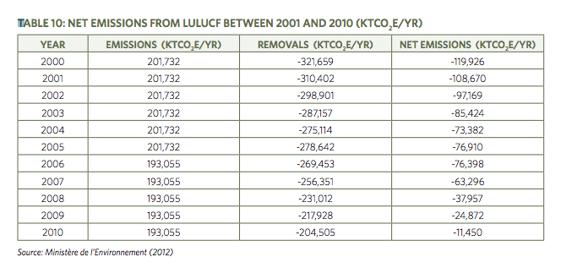
Here is Exhibit A – a standard table

Slide 8
It’s for the Democratic Republic of Congo!
Here’s the URL:
http://www.iisd.org/pdf/2013/rep_of_congo_greenhouse_gas.pdf
Something odd, perhaps significant: the six-digit figures for Emissions don’t change for five or six years in a row.

Slide 9
The people who publish this nonsense sometimes know that it is nonsense!
These multi-digit numbers are accurate to ±50%.
But the scientists are constrained by the conventions to write precise nonsense,
And they reserve their understanding to the methodological footnotes for experts.

Slide 10
Sometimes the authors accompany their data with ‘annihilatory caveats’.
Thus Siglitz, Sen & Fitoussi, in their great magisterial work on Indicators, have a table with quite ordinary precision of values…

Slide 11
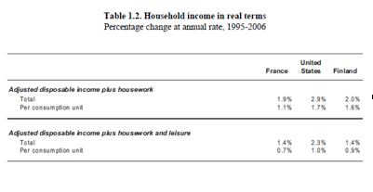

Slide 12
And below that there is the comment:
“(54) The imprecision associated with the above estimates should be reiterated here. These are orders of magnitude at best and should not be over-interpreted.”
What are we to make of that?
How many of the other data analysed in their book have the same imprecision?

Slide 13
Where does this leave the science depending on economic, social and environmental data?
What about the compounded indicators which are so widely used for policy?
When scholars of such distinction make such statements, we know that something is seriously wrong.
This convinces me that I am on to something important.

Slide 14
Finally there is ‘the formula that killed Wall Street’, the infamous ‘Gaussian copula’.

Slide 15
The significant thing about it is what the ‘Quants’ assumed.
That is, that the uncertainties of their arcane, hyper-complex ‘products’
Behaved like a ‘normal’ distribution, with an assignable standard deviation, σ.
And hardly anyone said ‘nonsense’.

Slide 16
I argue that the cause of this bad scene is that we are conditioned to a faith:
Numbers are nuggets of truth – pure and unconditioned.
Why is this believed so universally?
It goes back to the Scientific Revolution, when mathematics was believed to be the one and only way to Truth.

Slide 17
Now numbers have an emotional function.
My colleague Rafael Ramirez calls them ‘Teddy Bear numbers’.
When managers see a Spreadsheet with rows and columns full of numbers, they feel secure.
That’s why serious unlearning is necessary.

Slide 19
Individually, these little paradoxes are not significant for practice.
But they indicate a situation, where practice is not informed by theory as it is believed to be.
More serious is NEOSD – ‘not even one significant digit’.
How many complex compounded indicators have an uncertainty guaranteed to be less than 10%?
The others are, in principle, NEOSD, like the ones cited by Stiglitz, Sen & Fitoussi.
Where do we go from there?

Slide 20
I have presented bits of evidence to suggest that our inherited system of arithmetic is inadequate to the requirements of our uncertain, complex policy process.
Subversively, we might recall that the Chinese bureaucracy did pretty well for a couple of thousand years in spite of lacking spreadsheets.

Slide 21
Let’s start with the technology of information.
Cuneiform is obsolete!
We no longer need to record information exclusively in a static form.
With IT, information becomes a flow and a dialogue.
How can we exploit this new technology to develop our language of arithmetic?

Slide 22
We can now begin to design our arithmetical notations, so that forms integrate with functions.
The variety of contexts, meanings, and degrees of uncertainty and quality can now be represented with clarity and nuance.
This is the exciting prospect opened by IT.

Slide 23
We start with NUSAP, the notational system for representing Uncertainty and Quality.
The acronym starts at the ‘hard’, conventional end: Numeral, Unit, Spread.
At the ‘soft’ end we have Assessment, and finally Pedigree, a coded normative description of the history and/or function of the item.

Slide 24
NUSAP was first developed by Silvio Funtowicz and myself, and published in Uncertainty and Quality in Science for Policy, in 1981.
The idea of NUSAP has been adopted by the Dutch Environmental Agency in their Guidance.
Combined with IT, NUSAP can provide a framework for a conversation:
Let every heading become a hyperlink!
This could revolutionise the presentation of tabular information.

Slide 25
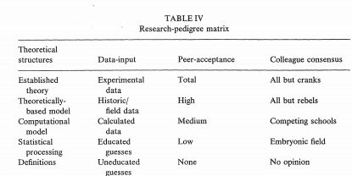
Here is a sample Pedigree.

Slide 26
Leaving aside Unit for now, let us consider Numeral for the NEOSD case.
For that we have ‘sparse digits’.
In the case of ‘roughly’, they would be 1, 2, 5, 10.
It could be a wonderful exercise in awareness, for scientists to re-write 66.2 as ’50’.
The full set of sparse digits is then:

Slide 27
              within sparse
name spread factor scale
roughly ±1/3 2 1, 2, 5, 10
ball park of ±2/3 5 1, 3, 10
order of magnitude 10 1, 10

Slide 28
I should remark that this is a design exercise, of which this version is an early draft.
I am inclined to have ±1/2 for ‘ball park’, but that would not fit so well with the other entries.

Slide 29
And now for the final treat: dynamical graphics.
The geometry of classical Greece is a language in which logical connections are made by constructions of a restricted sort: ‘ruler and compass’, providing a ‘visual proof’.
I propose to use computer graphics to represent arithmetical operations, providing a ‘visual dialogue’.

Slide 30
Finally, I offer a speculative idea that might prove to be the most powerful of all.
Before there was convenient computing power, there were ‘nomograms’.
They are now nearly forgotten.
Here is the sample, from Wikipedia.
This is totally transparent and participatory.

Slide 31
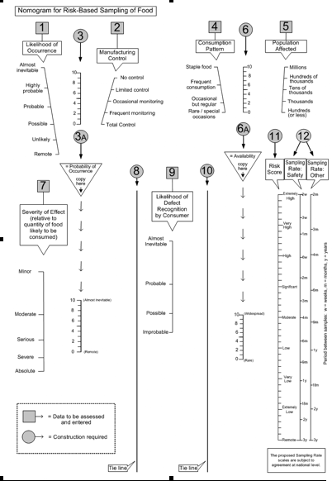

Slide 32
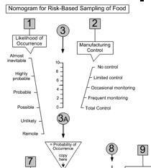

Slide 33
If we think of this little diagram as a simple model, all sorts of things happen.
If we approached it numerically, it would either be a set of equations, or a spreadsheet.
Either is nearly opaque.
But here we can say that “a picture is worth a thousand numbers”.

Slide 34
We can ask, why one input line is longer than the other, and why is the output line in the middle so short.
We can ask whether the different categories should be equally spaced, and whether they should be different.
We should notice that we are spared a lot of pseudo-precision!

Slide 35
Now imagine that the lines and points were replaced by ‘blobs’, either ‘caterpillars’ or discs.
Imagine that their uncertainties were represented by width of blob.
And the propagation of uncertainty through the calculation were displayed by the widening of the blobs.
There would then be total transparency!

Slide 36
Conclusion
I have taken us from the challenges of integrity and credibility to a vision of a transparent, participatory technology of mathematics in policy.
En route I have engaged with the problem of representation of inexact quantities, especially the NEOSD sort.
The relevance to the extended indicators of environment and society is obvious.
We have covered a lot of ground, and I appreciate your hard work in following me.

Slide 37
Click here to view New Arith Language 4Z07
https://www.dropbox.com/l/ZAS8MpfhJ3u94NBxHMRR7v

